Slide 1
List
SARS‐CoV‐2 genome sequences predict
CNN-LSTM for MRI image

Slide 2
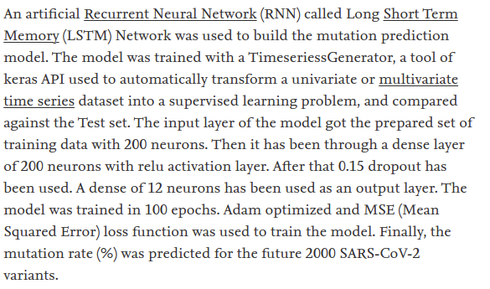
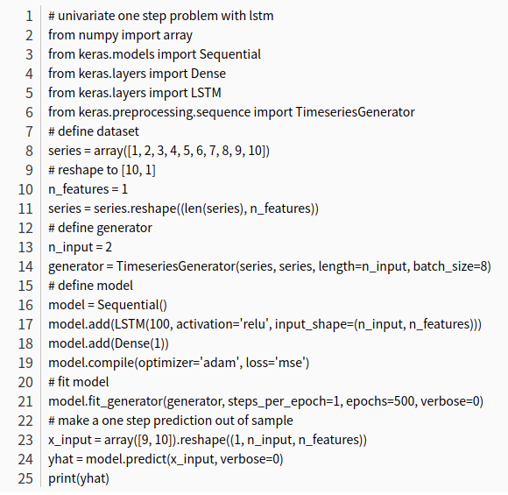
Genome-wide identification and prediction of SARS-CoV-2 mutations show an abundance of variants: Integrated study of bioinformatics and deep neural learning ◎
Notes:
針對基因序列的組合去做預測 例如未來哪幾個組合會出現 哪幾個可能不會在出現
keyword: genomic, covid-19, LSTM, SARS-CoV-2, sequence, predict

Slide 3
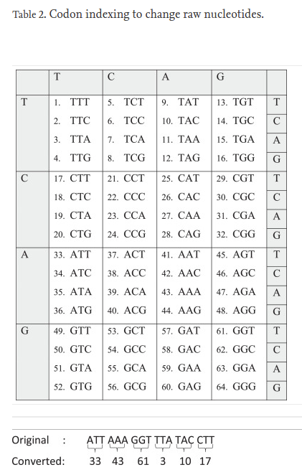
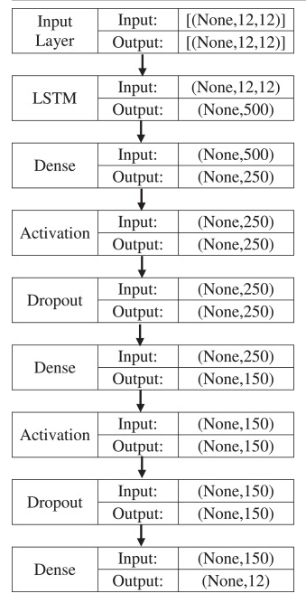
Time series prediction of COVID-19 by mutation rate analysis using recurrent neural network-based LSTM model ◎

Slide 4
Predict mutation
Explainable deep neural networks for novel viral genome prediction ◎
CNN+LSTM
Analyzing hCov Genome Sequences: Predicting Virulence and Mutation ◎
https://github.com/pythonLoader/Analyzing-hCov-Genome-Sequence
ML+DL

Slide 5
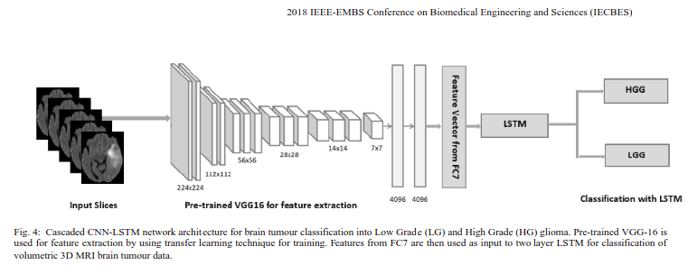
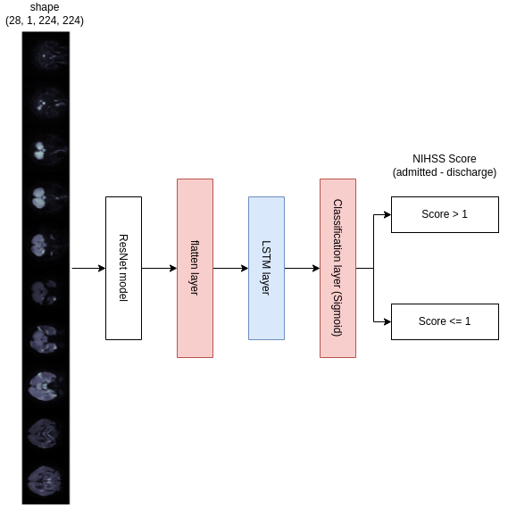
CNN-LSTM

Slide 6
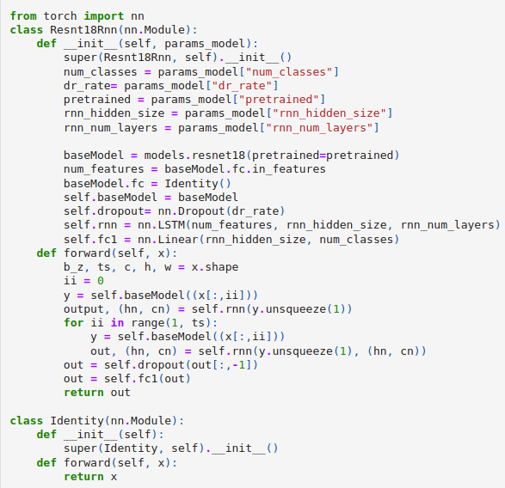
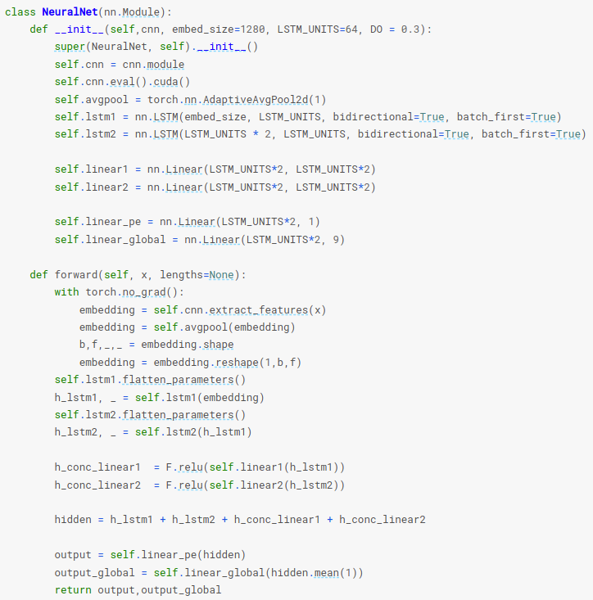
LSTM-CNN

Slide 7
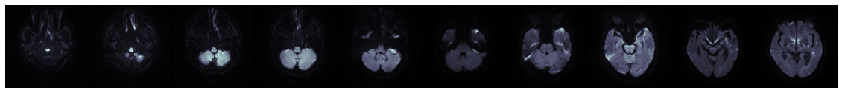

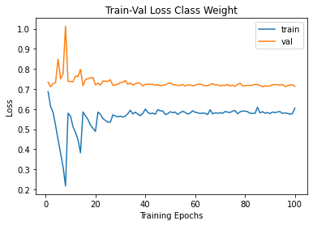
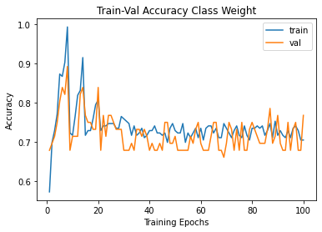
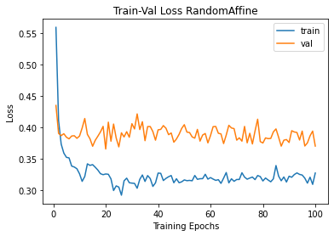
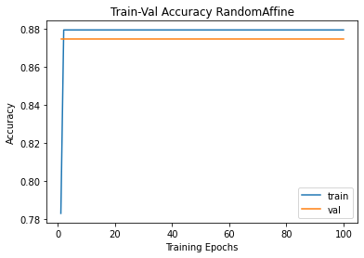
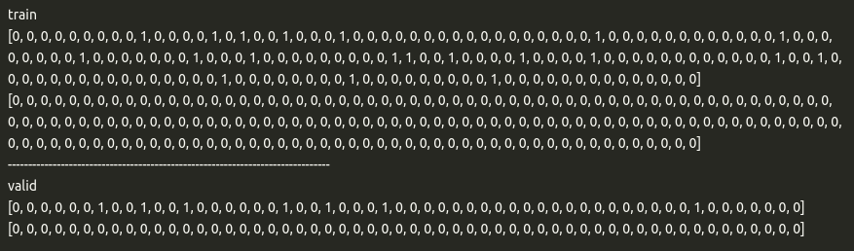
MRI to video slice
Notes:
384,384 會導致當前的記憶不足
影像轉換階段會失真 -> 在dataloader裡直接轉換

